Slide 1
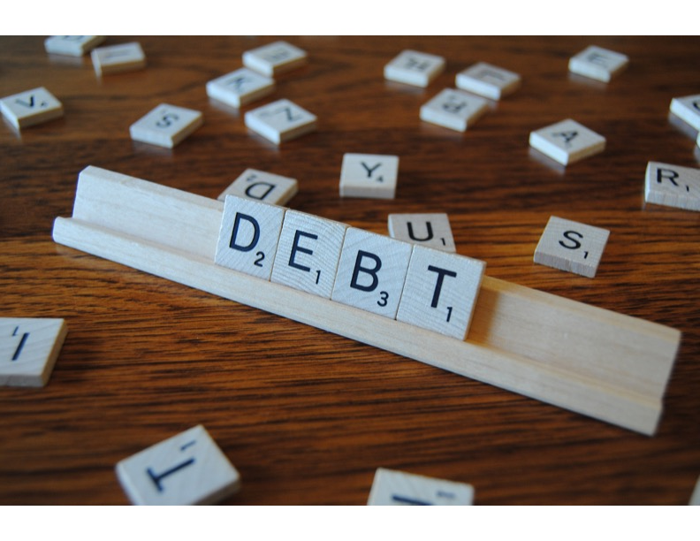
How Does Debt Work Workshop

Slide 2
What is Debt?
Exchange of goods, services or cash for the promise of a future payment of goods, services or cash that generally includes interest
Future payment can all be due at a future date, or more often payment is made in installments

Slide 3
When is Debt Used?
Often debt is used when a large asset is purchased such as a house or car
Uses future earnings to repay the debt
Makes the most sense for the purchase of an appreciating asset

Slide 4
Debt for a Home
Purchase a home for $250,000 and assume 2% appreciation.
Borrowed $200,000 with a 30-year mortgage at 4%.

Slide 5
Debt for a Car
Purchase a new car for $25,000.
Finance for five years at 4%.

Slide 6
When is Debt Used?
Borrowing to pay current expenses
Happens if monthly expenses exceed monthly income
Could be large or impulse purchases
Often by use of credit cards
Not sustainable

Slide 7
How Does Debt Work?
There are three factors at play with debt
How much you borrow
How long you borrow it for
The interest rate

Slide 8
How Does Debt Work?
The interest charged by the lender for debt begins accruing the date you borrow the money through the date the loan is paid off
All payments are applied first to interest owed then to the balance owed
Formula for calculating interest is Balance owed x Rate x Period = Interest owed

Slide 9
How Does Debt Work?
Example of a simple loan:
You borrow $10,000 for one year at 8% interest
How much would you owe when the debt comes due?
$10,000 x 8% x 1 = $800 of interest
Repayment = $10,000 + $800 = $10,800

Slide 10
How Does Debt Work?
Installment loans
Most common
Generally are for periods of more than one year
Partial payments are made monthly
Each monthly payment includes an element of interest and reduction of the balance owed

Slide 11
How Does Debt Work?
Example installment loan:
You borrow $10,000 for one year at 8% interest with a payment of $869.88 due at the end of each month

Slide 12
How Does Debt Work?
 | Balance | Payment | Interest | Payment | Remaining
Month | Owed | Made | Owed | of Balance | Balance
1 | 10,000.00 | 869.88 | 66.67 | 803.21 | 9,196.79
2 | 9,196.79 | 869.88 | 61.31 | 808.57 | 8,388.22
3 | 8,388.22 | 869.88 | 55.92 | 813.96 | 7,574.26
4 | 7,574.26 | 869.88 | 50.50 | 819.38 | 6,754.88
5 | 6,754.88 | 869.88 | 45.03 | 824.85 | 5,930.03
6 | 5,930.03 | 869.88 | 39.53 | 830.35 | 5,099.68
7 | 5,099.68 | 869.88 | 34.00 | 835.88 | 4,263.80
8 | 4,263.80 | 869.88 | 28.43 | 841.45 | 3,422.34
9 | 3,422.34 | 869.88 | 22.82 | 847.06 | 2,575.28
10 | 2,575.28 | 869.88 | 17.17 | 852.71 | 1,722.57
11 | 1,722.57 | 869.88 | 11.48 | 858.40 | 864.17
12 | 864.17 | 869.88 | 5.76 | 864.12 | 0.05
 |  | 10,438.56 | 438.61
Interest amount for payment 1 is $10,000 x 8% x 1/12 = $66.67
Total interest paid on this loan is less than the $800 in the first example.
Why??

Slide 13
Credit Card Debt

Slide 14
Can I Pay Down Debt Faster?
Yes!!!!!
Any additional amount you pay above your required payment reduces the debt amount which pays the loan off much quicker (https://www.youtube.com/watch?v=y97rBdSYbkg)
See https://www.ramseysolutions.com/real-estate/mortgage-payoff-calculator

Slide 16
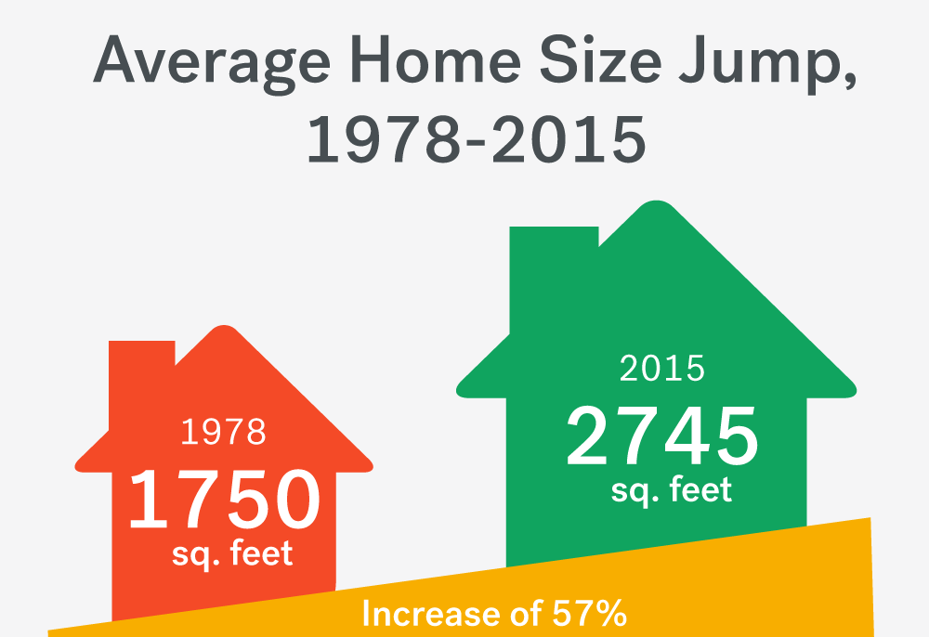
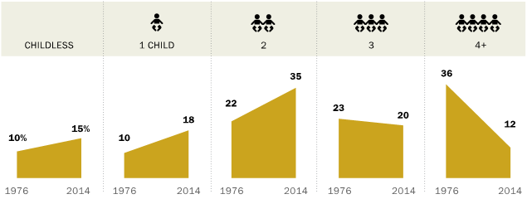
1. Mortgage Is 30% or More of Your Income
2. Putting off Routine Home Maintenance
3. Property Tax Increases Stress You Out
4. Not Saving for Your Retirement
5. Making Monthly Minimum Payments on Your Credit Cards

Slide 17
Other Considerations
Beware of no-interest or same as cash deals!!
Consolidation is not a silver bullet
You still owe the same amount
What do you do each month with any savings from consolidation?

Slide 18
The rich rule over the poor,
and the borrower
is slave to the lender
Proverbs 22:7

