Slide 1
Paying for College Workshop

Slide 2
Planning for College
Begin planning as early as possible
Parents provide guidance, students to show commitment to the process
Discuss and decide who is going to be responsible for paying for college costs
Learn how much college costs and how those costs vary by school

Slide 3
Be Prepared for College
Know what you want to do
Academics matter
Character matters

Slide 6
Indiana College Tuition Only
$53,218
$38,360
$41,050
$10,388
$10,002
$9,654
$35,514
$28,650
$27,420
$9,205
$8,746
$4,368
IU/PU Extensions approximately $7,269

Slide 7
How to Reduce the Cost of College
Finding money
Scholarships and grants
Merit based and needs based
Complete your FASFA

Slide 8
How to Reduce the Cost of College
Save money on college cost
Community college or state school
Live at home
Modern States Education Alliance
Work study programs
Work up to 20 hours while in school

Slide 9
Coming-up with the Cash for College
Saving for College
529 plans
ESA and other plans
Working prior to and during college

Slide 10
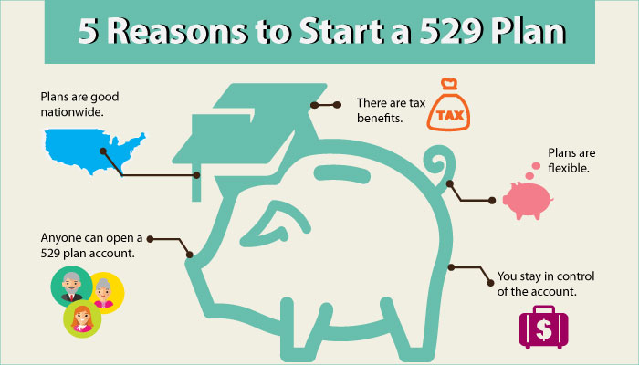

Slide 11
529 Myths
Myth 1: If my child doesn't go to college, I lose all the money in my account.
Reality: You will never lose all of the money. Here are some options:
Use the funds to pay for community college, vocational school or other eligible post-secondary education.
Change the beneficiary to a sibling or other qualifying family member who will attend college.
Use the money to pay for your own continuing education.
Save the funds for a future grandchild.
Funds can be used to pay off up to $10,000 of student loan debt per beneficiary.
Take a non-qualified withdrawal and pay income tax and a 10% penalty on the earnings portion of the withdrawal. Your contributions were made with after tax money and therefore will never be taxed or penalized.

Slide 12
529 Myths
Myth 2: If my brilliant or athletic kid gets a full ride, I lose the money in my account.
Reality: Again, you will never lose all of the money. Here’s why:
When you take a non-qualified withdrawal from a 529 plan, you will incur income tax and a 10% penalty on the earnings portion of the withdrawal. The principal portion will never be taxed or penalized.
But there’s a special exception to the 10% penalty when the beneficiary dies, becomes disabled, decides to attend a U.S. Military Academy or earns a scholarship.
Students can avoid the 10% penalty on non-qualified withdrawals up to the amount of the tax-free scholarship. The earnings portion of the withdrawal, however, will still incur income tax.

Slide 13
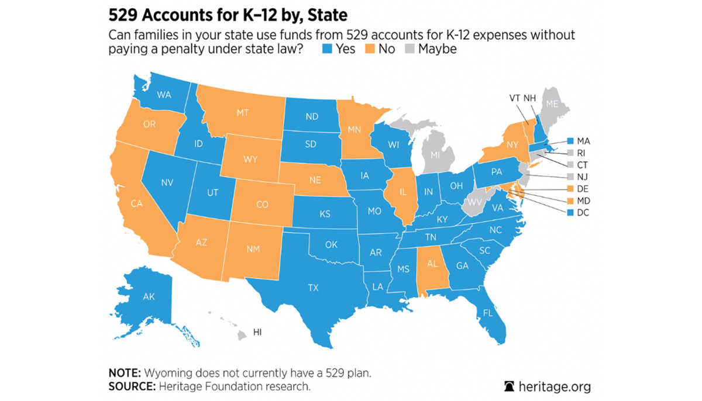
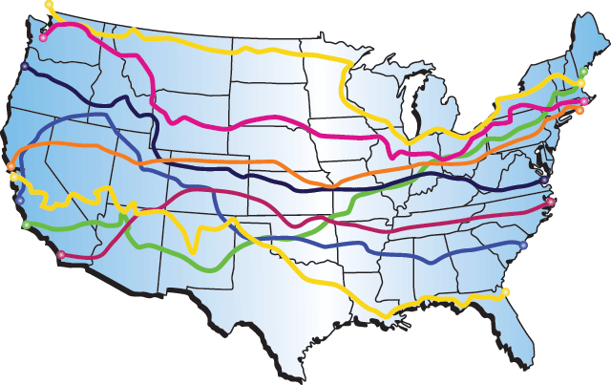
529 Myths
Myth 3: I can only invest in my home state's plan.
Reality: You can enroll in most any state’splan, no matter where you live, but:
Check with your home state’s plan first
Currently, 35 states including the District of Columbia, offer a state tax credit or deduction for 529 plan contributions.
Most of these states require that you invest in your home state’s plan, but seven states will offer a tax benefit for contributions to any state’s plan.
Indiana Tax Credit of 20% of contribution with a $1,000 max per year.
Your student can attend college in any state in any eligible institution

Slide 14
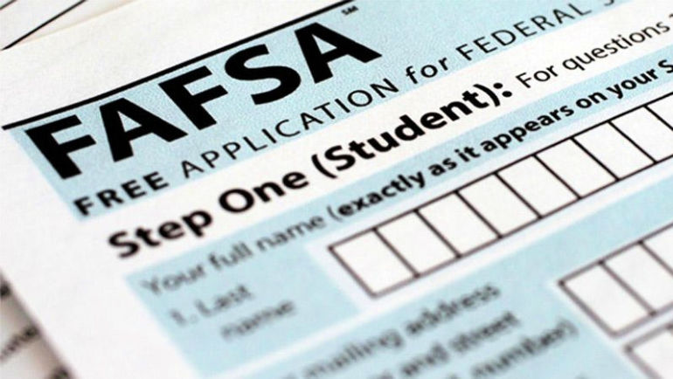
529 Myths
Myth 4: I won't get financial aid if my child has a 529 account.
Reality: A 529 plan will affect financial aid eligibility, but the impact will be very small.
529 accounts owned by a student or one of their parents receive favorable treatment on the FAFSA.
Typically, 20% of a student’s assets are considered available funds to pay for college.
But money saved in a student-owned 529 plan is considered a parental asset, which means student’s aid package would only be reduced by up to 5.64% of the account value.
What’s more, you will not have to report the funds withdrawn as student income on the FAFSA when they’re used to pay for college.
Withdrawals from other savings vehicles, such as Roth IRAs, will be counted as student income and are assessed at up top 50%, so a $10,000 withdrawal can reduce a student’s aid eligibility by $5,000.

Slide 15
How to Pay for College
Student loans
Federally subsidized loans
Private loans

Slide 17
Private Loans Are Just That
Five Factors to Consider.
You'll likely pay higher interest rates. ...
You might not get approved on your own. ...
You won't get access to income-driven repayment plans.
Loan Forgiveness is not really an option
You will need to research lenders

Slide 18
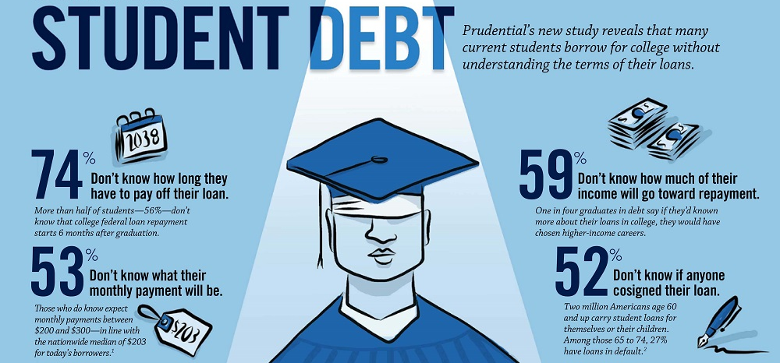

Slide 19
Common Mistakes
Student is not ready for college
College is not always the right option
Be careful of the “Dream School”
Using student loans for other than college expenses
Relying on credit cards for living expenses

Slide 20
Debt free College is Possible
Video Clip
Debt Free Degree by Anthony Oneal

Slide 21
Debt Free Degree
Key Concepts
Plan In Advance
Talk With your Kids
Encourage Them To Work
Set Up Savings Vehicle
Apply For Scholarships And Grants
Grades, ACT and SAT Scores Matter
Get And Stay Debt Free
College Choice

Slide 22
Information
https://research.collegeboard.org/trends/college-pricing
https://www.ramseysolutions.com/saving/college-savings-calculator?snid=free-tools.college.college-savings-calculator
https://www.ramseysolutions.com/debt/student-loan-payoff-calculator?snid=free-tools.managing-money.student-loan-payoff-calculator

Slide 23
Information
Scholarships.com
https://www.savingforcollege.com
https://fox59.com/news/indynews/i-just-dont-want-to-be-in-debt-ball-state-students-blanket-business-helps-pay-off-school-fees/
https://modernstates.org

Slide 24
Questions ?
personalfinance@fishersumc.org

